Slide 1
Electric Fields: Coulomb’s Law
Content Development
A sodium ion has a +1 relative atomic charge which indicates it has one more proton than electron. This ion is placed in a 4.00 NC⁻¹ electric field.
Calculate the force applied to a single sodium ion in this electric field
A different ion is placed in the electric field. It moves in the opposite direction to the sodium ion and experiences a 1.28 * 10⁻¹⁸ N force. Calculate the relative atomic charge of the ion.

Slide 2
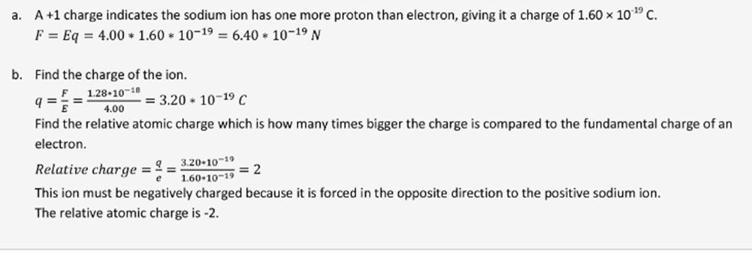
Electric Fields: Coulomb’s Law
Content Development
A sodium ion has a +1 relative atomic charge which indicates it has one more proton than electron. This ion is placed in a 4.00 NC⁻¹ electric field.
Calculate the force applied to a single sodium ion in this electric field
A different ion is placed in the electric field. It moves in the opposite direction to the sodium ion and experiences a 1.28 * 10⁻¹⁸ N force. Calculate the relative atomic charge of the ion.

Slide 3
Work in an electric field
Success Criteria
I can calculate the work done on a charged object by an electric field

Slide 4
Work in an electric field
Content Development
A charged moving through a field has work done on it (a force is moving an object a distance).
Work is a change in an energy. The energy of an object is due to its location in the electric field.
If the charged object is moving in the direction it would naturally go in the field, the work is being done by the field.
If it is moving against the natural direction, the work is being done on the field.
If it is moving perpendicular to the field, no work is being done.
+
Notes:
How would a positive charge be affected by this field?
1. Positive charge moves with the field. Work is being done by the field
2. Positive charge moves against the field. Work is being done on the field.

Slide 5
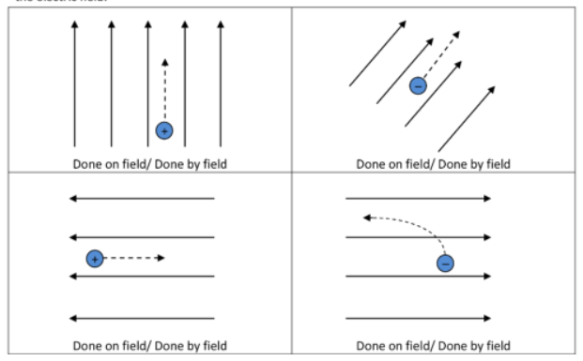
Work in an electric field
Content Development
Is work done by the field or on the field?
Notes:
TL: Done by field
TR: Done on field
BL: done on field
BR: done by field

Slide 6

Work in an electric field
Content Development
Compare gravitational and electric fields:
To move the book onto the box, we have to do work. We are doing work to the gravitational field.
This results in an increase in the book’s gravitational potential energy. The book has more energy due to its location in the gravitational field.
The more mass the book has, the more work we had to do to change its location.
Notes:
Focus on potential energy

Slide 7
Work in an electric field
Content Development
Compare gravitational and electric fields:
To move the charged object, we have to do work. We are doing work to the electric field.
This results in an increase in the object’s electric potential energy. The object has more energy due to its location in the electric field.
The more charge the object has, the more work we had to do to change its location.
+
Notes:
Focus on potential energy

Slide 8


Work in an electric field
Content Development
Electric potential difference
Electric potential is the “potential energy per unit of charge”
Electric potential difference is the difference in the electric potential between two points.
V = potential difference (V or JC⁻¹)
W = work (J)
q = charge (C)
F = force (N) s = displacement (m)

Slide 9
Work in an electric field
Content Development
Electric potential vs Gravitational potential
Gravity: W = ΔPE = m g ∆h
mass = the amount of substance affected by the field
g = gravitational field strength
Δh = the change in location
Electric: W = Vq = q E d
q = the amount of substance affected by the field
E = electric field strength
d = the change in location

Slide 10
Work in an electric field
Content Development
Electric potential vs Gravitational potential
The difference is that, with gravity, we talk about absolutes (the energy of the object). With electric fields, we talk about differences per unit of charge.
Gravity style
Electric style
10 kg
1m
ΔPE = mg∆h
ΔPE = 10 * 10 * 1
ΔPE = 100 J
ΔPE per kg = mg∆h / m
ΔPE per kg = 10 * 10 * 1 / 10
ΔPE per kg = 10 Jkg⁻¹
10 kg
10 J of work is required to move the object per kilogram

Slide 11
Work in an electric field
Content Development
Electric potential vs Gravitational potential
The difference is that, with gravity, we talk about absolutes (the energy of the object). With electric fields, we talk about differences per unit of charge.
10 C
Gravity style
Electric style
+
1m
ΔPE = W = qEd
ΔPE = 10 * 10 * 1
ΔPE = 100 J
V = ΔPE per C = qEd / q
V = 10 * 10 * 1 / 10
V= 10 JC⁻¹ = 10 V
+
10 C
10 J of work is required to move the object per coulomb of charge
Electric field strength = 10 NC⁻¹

Slide 12
Work in an electric field
Content Development
A charged dust particle enters a 200 NC⁻¹ electric field in the direction shown below. The dust particle carries a -2.30*10⁻⁵ C charge and has 50.0 mJ of kinetic energy upon entering the field.
It moves 3.00cm into the field.
Draw a freebody diagram and the electric field
Calculate the final kinetic energy of the dust particle
Calculate the potential difference the dust particle moved through
Notes:
W = Fs
Fe = Eq
Therefore W = Eqs (where E = electric field strength)
= 200 x 2.30*10⁻⁵ x 0.03 = 1.38 x 10^-4 J
KE final = KE initial – W = 50*10^-3 – 1.38*10^4 = 4.99*10^-2 J
V = W/q = 6 V

Slide 13
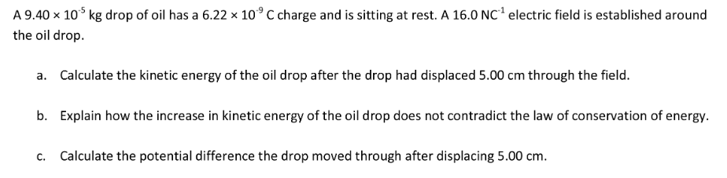
Work in an electric field
Content Development

Slide 14
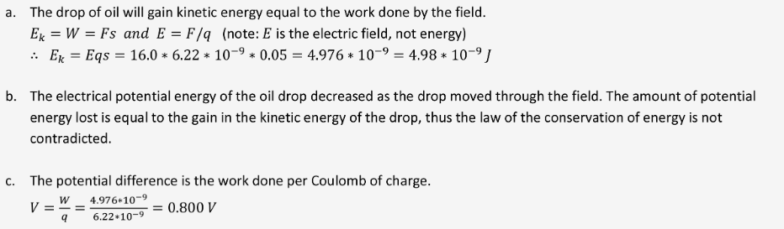
Work in an electric field
Content Development

Slide 15


Work in an electric field
Content Development
Imagine an electron at rest, sitting on the negative plate.
What direction would it move?
What is the work done on this electron?
+ + + + + + + + + + +
What is the final kinetic energy of the electron?
$$KE= \frac{1}{2}mv^{2}=qV$$
- - - - - - - - - - -
This is known as the ‘electron gun’ equation.
Notes:
Remember that the field at the edges of the plates has a curve.
Draw the field from +ve to –ve. It is the force that a positive charge experiences therefore away from the positive plate and towards the negative plate.
Link to cathode ray tubes.

Slide 16
Work in an electric field
Content Development
Two parallel plates are separated by 1.0cm. One plate is earthed and the other has a potential of 5.0kV.
Determine the final speed of a single electron when accelerating from rest across this potential difference.
charge of electron = -1.602 x 10⁻¹⁹ C mass of electron = 9.109 x 10⁻³¹ kg
b) Calculate the acceleration of the electron.
Notes:
a) ½ m v^2 = qV
v^2 = 2qV / m
v = 4.2 x 10^7 m/s
b) Electric field strength = V/d = 5.0 x 10^5 V/m
Fnet = ma = qE
a = qE / m
a = 8.8 x 10^-16 m/s^2

Slide 17
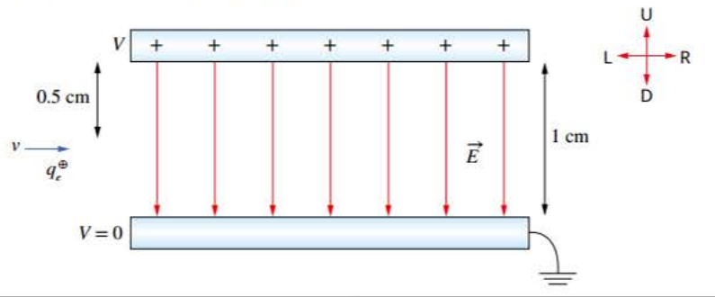
Work in an electric field
Content Development
Two parallel plates are separated by 1.0cm. One plate is earthed and the other has a potential of 5.0kV.
c) Now assume the initial velocity of the electron was 5.0x10^7 m/s travelling horizontally as it enters halfway between the plates. How long does it take for the electron to hit the positive plate?
charge of electron = -1.602 x 10⁻¹⁹ C mass of electron = 9.109 x 10⁻³¹ kg
Notes:
s = ut + 0.5at^2
0.005 = 0*t

Slide 18
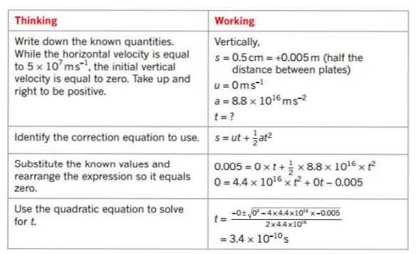
Work in an electric field
Content Development
Two parallel plates are separated by 1.0cm. One plate is earthed and the other has a potential of 5.0kV.
c) Now assume the initial velocity of the electron was 5.0x10^7 m/s travelling horizontally as it enters halfway between the plates. How long does it take for the electron to hit the positive plate?
charge of electron = -1.602 x 10⁻¹⁹ C mass of electron = 9.109 x 10⁻³¹ kg
Notes:
s = ut + 0.5at^2
0.005 = 0*t

Slide 19
Work in an electric field
Content Development
Two parallel plates are separated by 1.0cm. One plate is earthed and the other has a potential of 5.0kV.
d) Assuming the same conditions as for part c, calculate the final horizontal displacement of the electron.
charge of electron = -1.602 x 10⁻¹⁹ C mass of electron = 9.109 x 10⁻³¹ kg
Notes:
s = ut + 0.5at^2
0.005 = 0*t

Slide 20
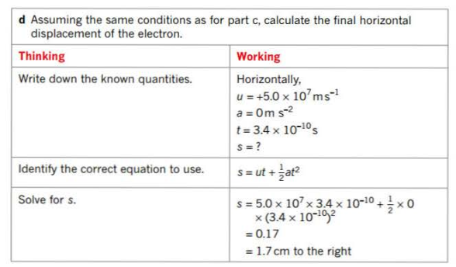
Work in an electric field
Content Development
Two parallel plates are separated by 1.0cm. One plate is earthed and the other has a potential of 5.0kV.
d) Assuming the same conditions as for part c, calculate the final horizontal displacement of the electron.
charge of electron = -1.602 x 10⁻¹⁹ C mass of electron = 9.109 x 10⁻³¹ kg
Notes:
s = ut + 0.5at^2
0.005 = 0*t

Slide 21
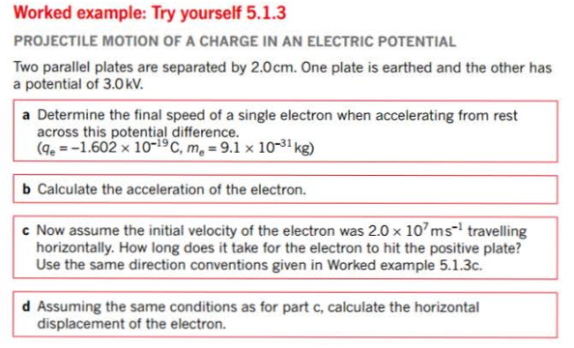
Work in an electric field
Content Development
Notes:
s = ut + 0.5at^2
0.005 = 0*t

Slide 22
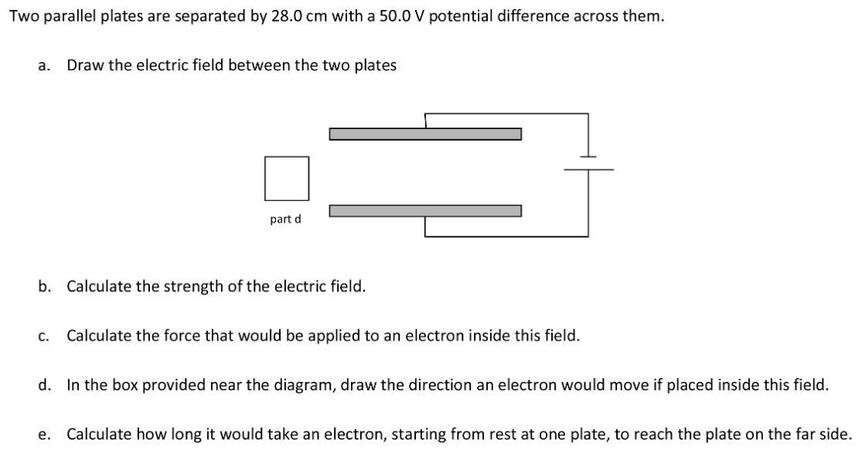
Work in an electric field
Content Development
Notes:
s = ut + 0.5at^2
0.005 = 0*t

Slide 23
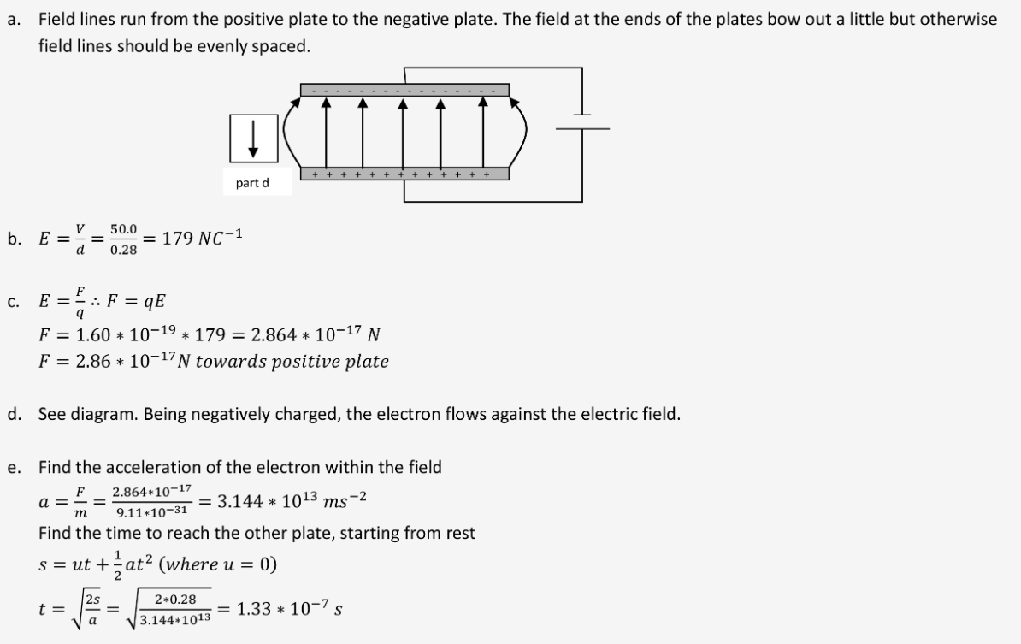
Work in an electric field
Content Development
Notes:
s = ut + 0.5at^2
0.005 = 0*t

Slide 24
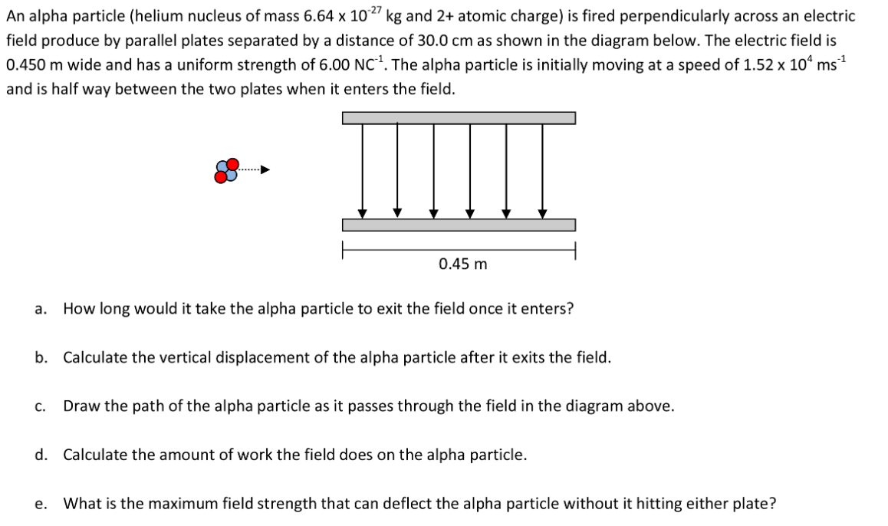
Work in an electric field
Content Development
Notes:
s = ut + 0.5at^2
0.005 = 0*t

Slide 25
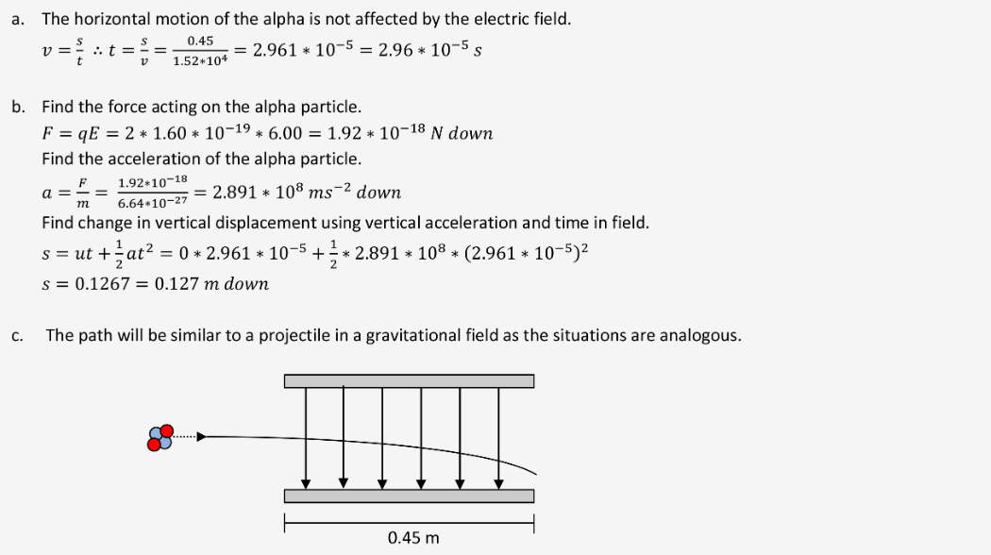
Work in an electric field
Content Development
Notes:
s = ut + 0.5at^2
0.005 = 0*t

Slide 26
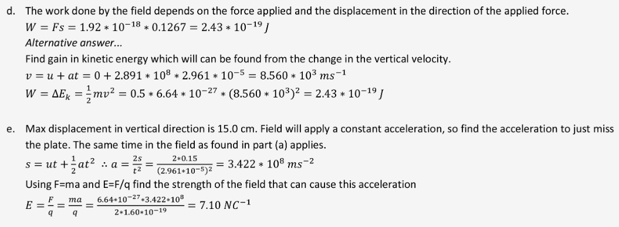
Work in an electric field
Content Development
Notes:
s = ut + 0.5at^2
0.005 = 0*t

Slide 27
Work in an electric field
Success Criteria
I can calculate the work done on a charged object by an electric field

Slide 28
Homework
STAWA Set 9 p 124
Questions 1, 2, 3, 5, 6, 7, 8, 9

Slide 29

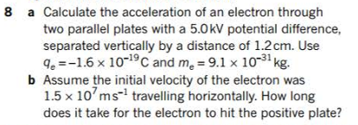
Work in Electric Fields
Additional Study
Notes:
a) 3 x 10^16 ms^-2 in the opposite direction to the field b) 4.0 x 10^-10 s

Slide 30
Electric Fields
Content Development
Videos on cathode ray tubes
https://www.youtube.com/watch?v=l4UgZBs7ZGo&t=551s&ab_channel=TechnologyConnections
https://www.youtube.com/watch?v=Rb6MguN0Uj4&t=491s&ab_channel=TylerDeWitt
https://www.youtube.com/watch?v=O9Goyscbazk&ab_channel=dchummerCHEMISTRY

